Slide 1

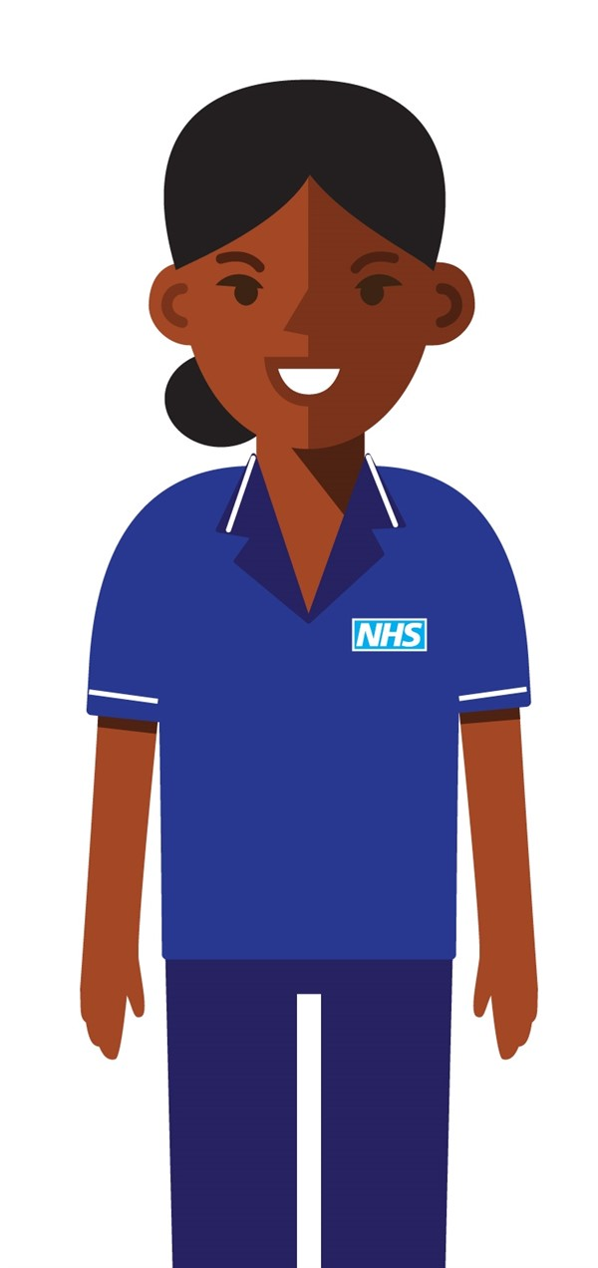


2-hour Urgent Community Response (UCR)
Do you know there are teams of advanced clinicians in your community who can respond within two hours if someone’s health or wellbeing suddenly deteriorates at home?
This can avoid the need for an ambulance and prevent hospital admission.
Do you know your UCR team?
    Advanced nurses and therapists can carry out assessments, order tests, diagnose, prescribe and order equipment within two hours of referral. They all operate 8am-8pm 7 days a week.
    The UCR team can keep the patient safe at home with the support of GPs, geriatricians, social care and other specialists
What is 2-hour crisis response?
What conditions are suitable for referral to your UCR team?
    If you think the patient could be admitted to hospital unless they are seen within two hours, call your UCR team.
    Here’s a list of the most probable scenarios:
Fall with no apparent serious injury (LIFTING RESPONSE AVAILABLE)
Decompensation of frailty
Reduced function/ deconditioning/reduced mobility
Palliative/end of life care crisis support (where core services not available)
Confusion/delirium
Unpaid carer breakdown which if not resolved will result in a health care crisis
Urgent equipment provision
How can you make a referral?
    We have UCR teams in each locality for Exeter, East and Mid Devon. The service runs 7 days a week between 0800-2000.
    To make a referral please call:
    0345 6007878
Find out more:
www.england.nhs.uk/community-health-services/community-crisis-response-services/

